Slide 1

ENME480 Lab 10 – IK Simulation, Cameras & Final Project Intro
Alex Beyer, Kaustubh Joshi

Slide 2
Announcements
Homework 4 is posted covering IK
Homework 5 will come out shortly after Homework 4 is due, will be a shorter homework focused on prep for Exam 2
This is our final lab in Kim! Every other lab will be in RAL

Slide 3
Todays Plan
Introduce final project
Describe camera lab
Using velocity kinematics to find singularities
Strategies for avoiding singularities
Quick numerical IK example
Time to work on simulating IK Lab

Slide 4
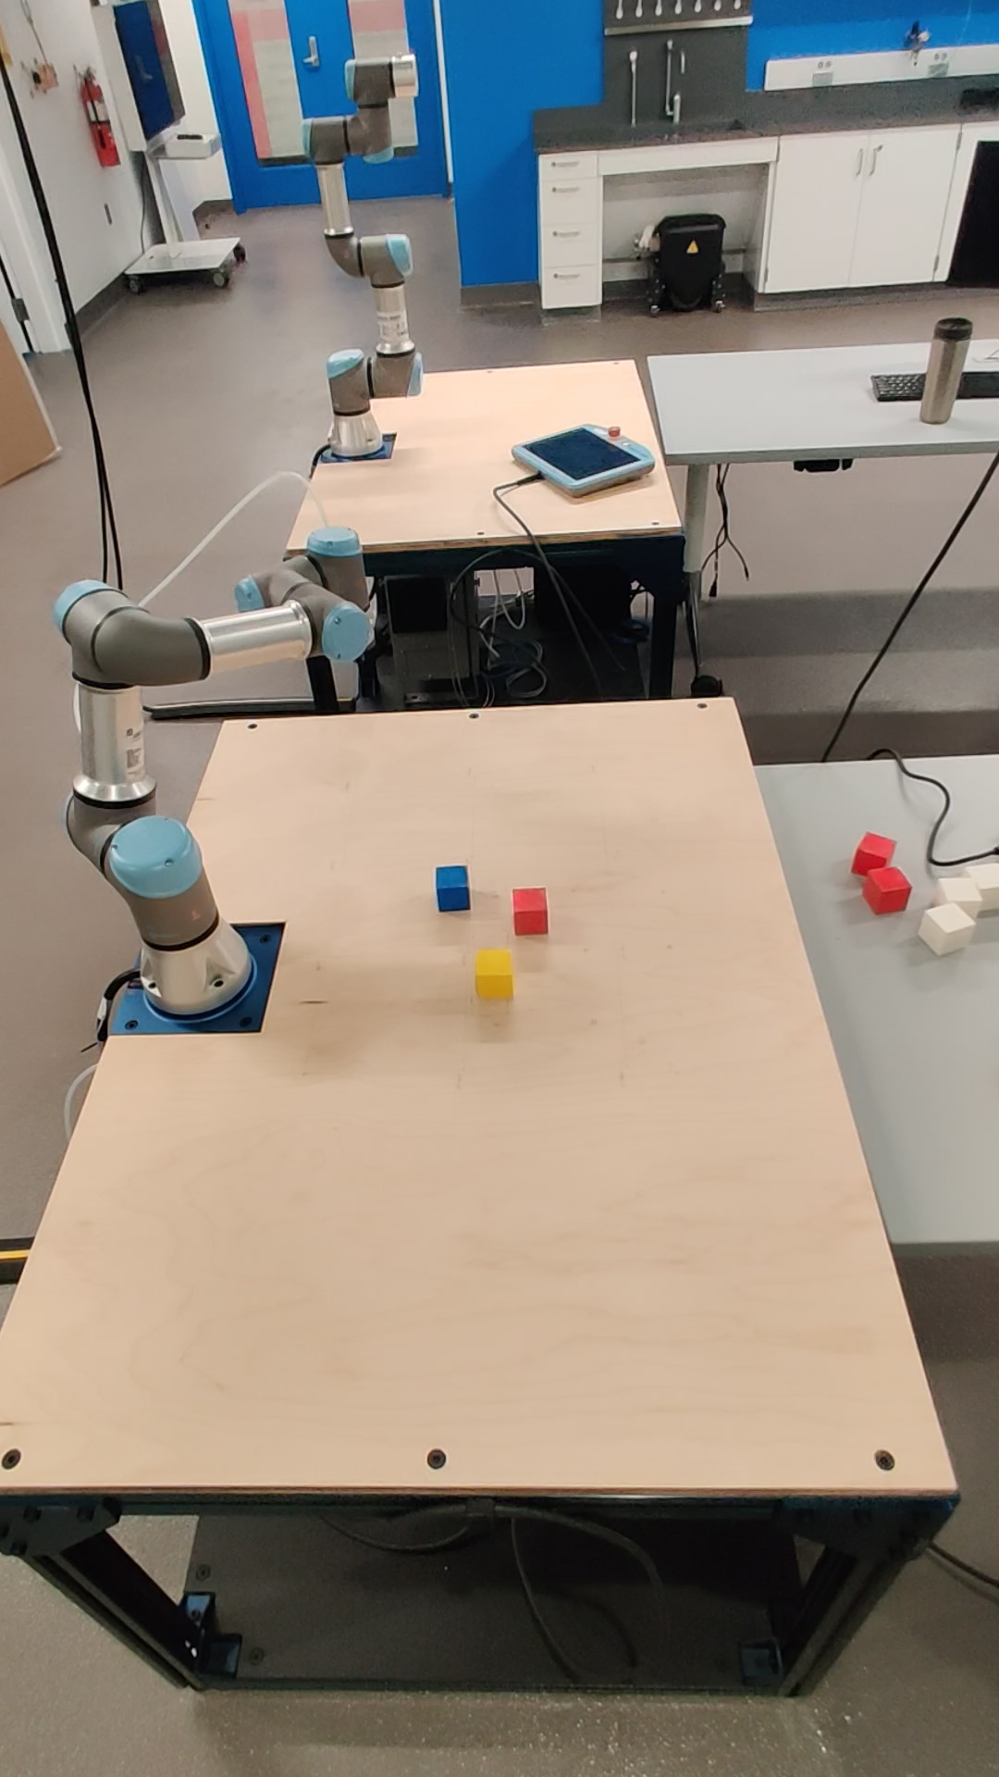
Final Project Intro

Slide 5
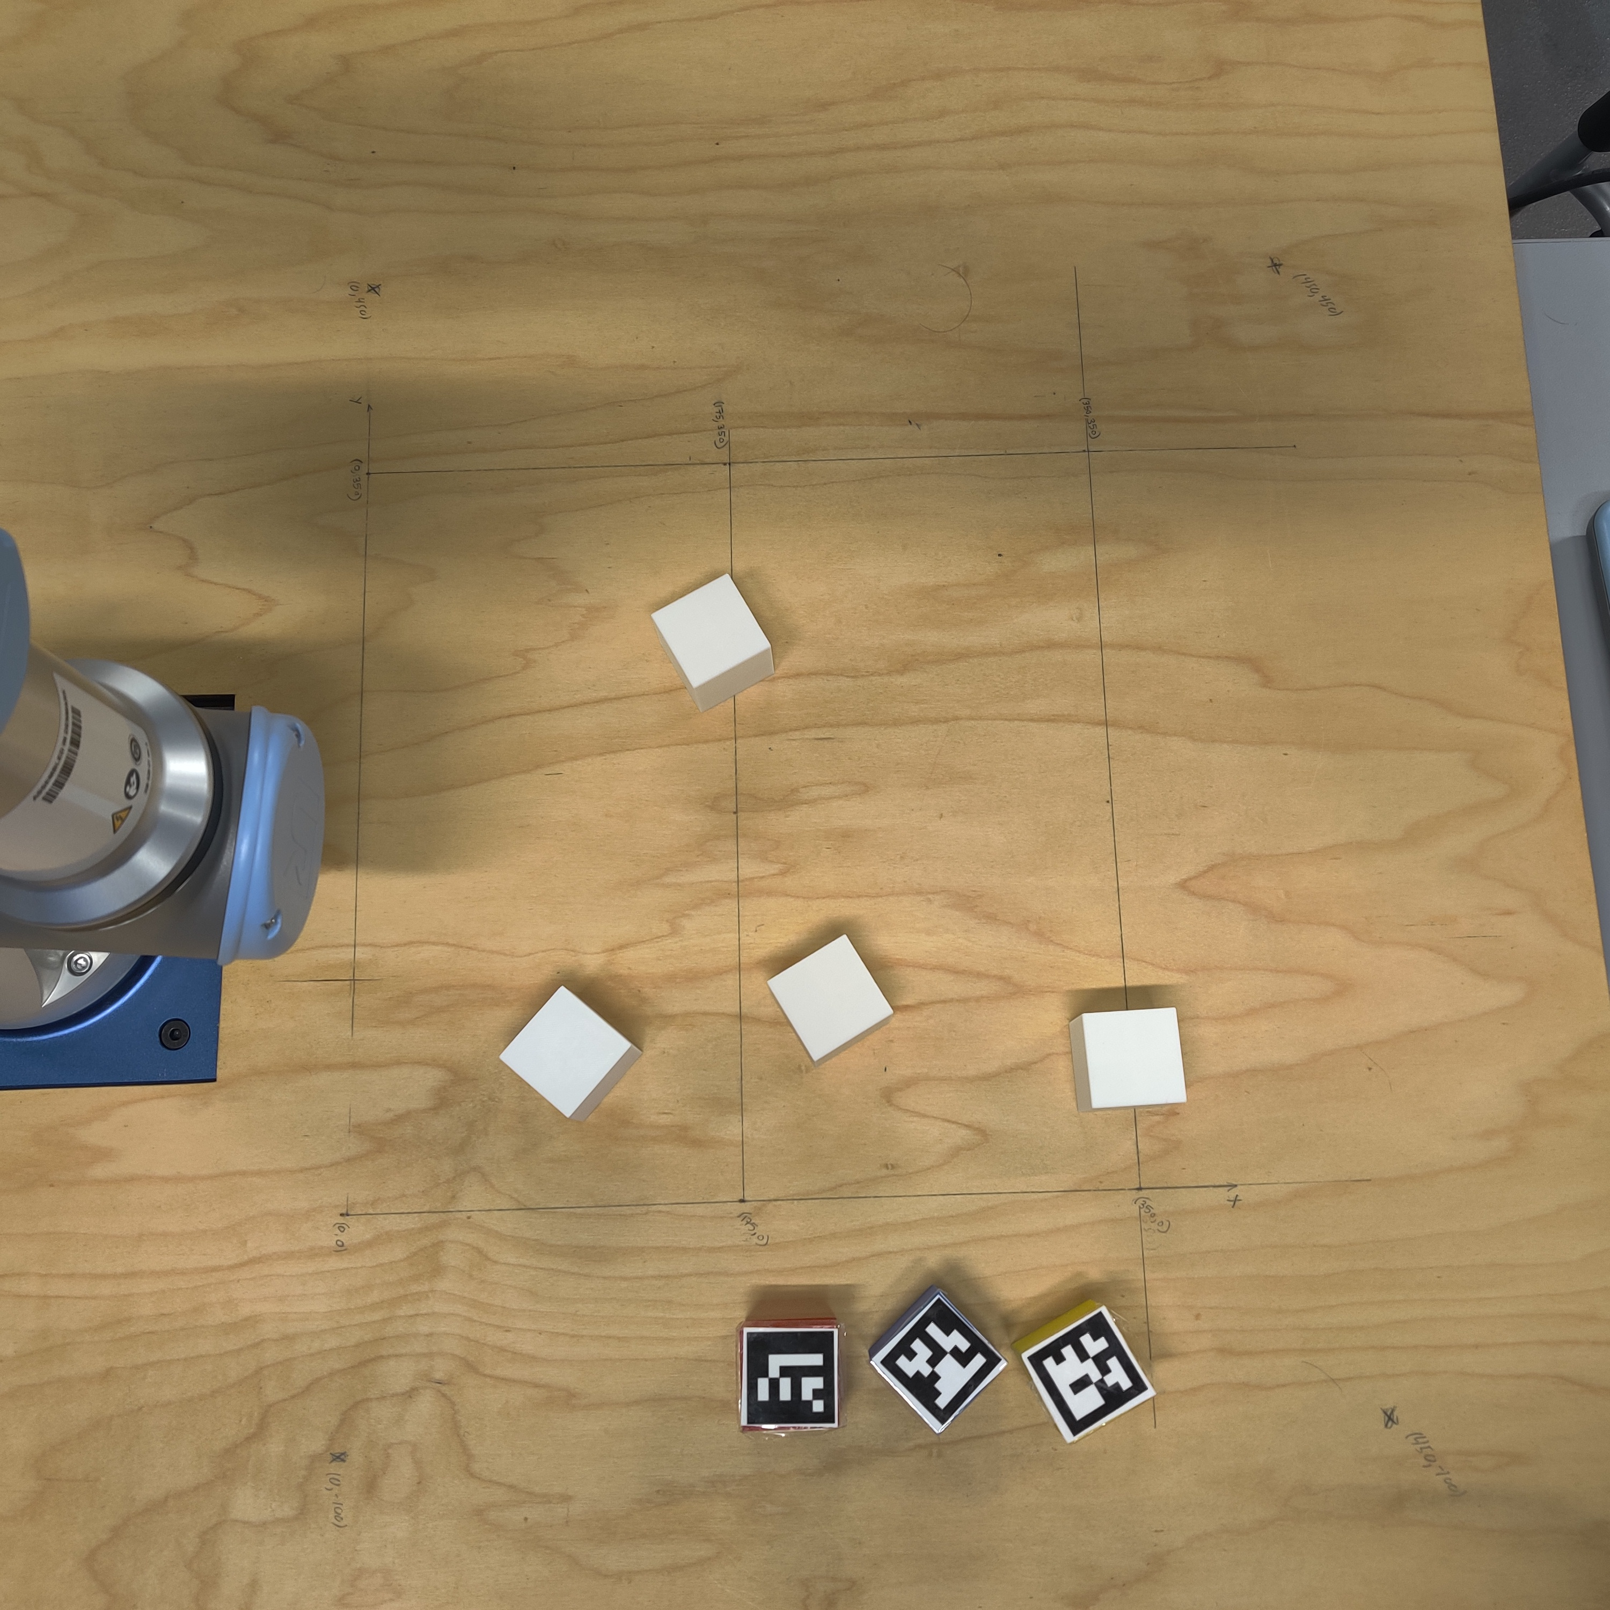
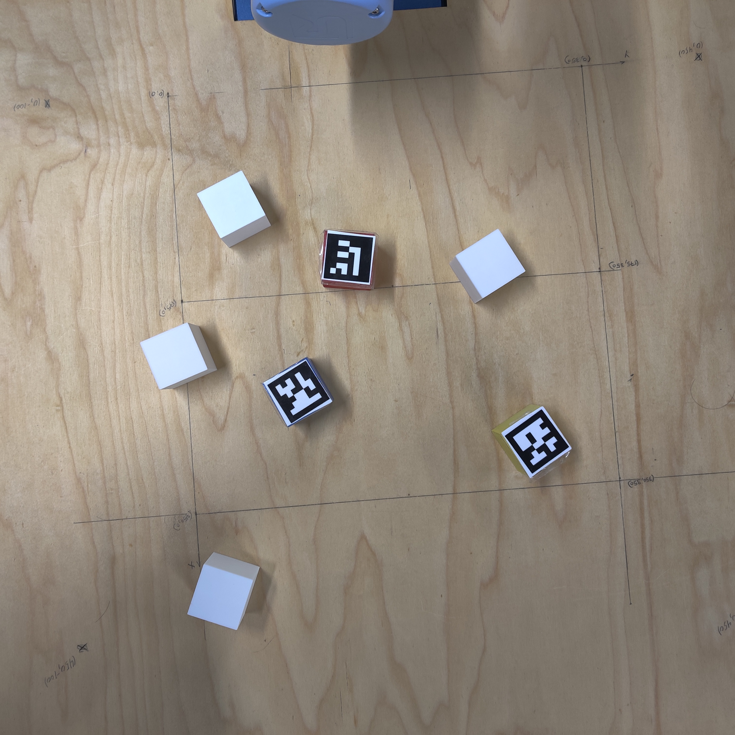
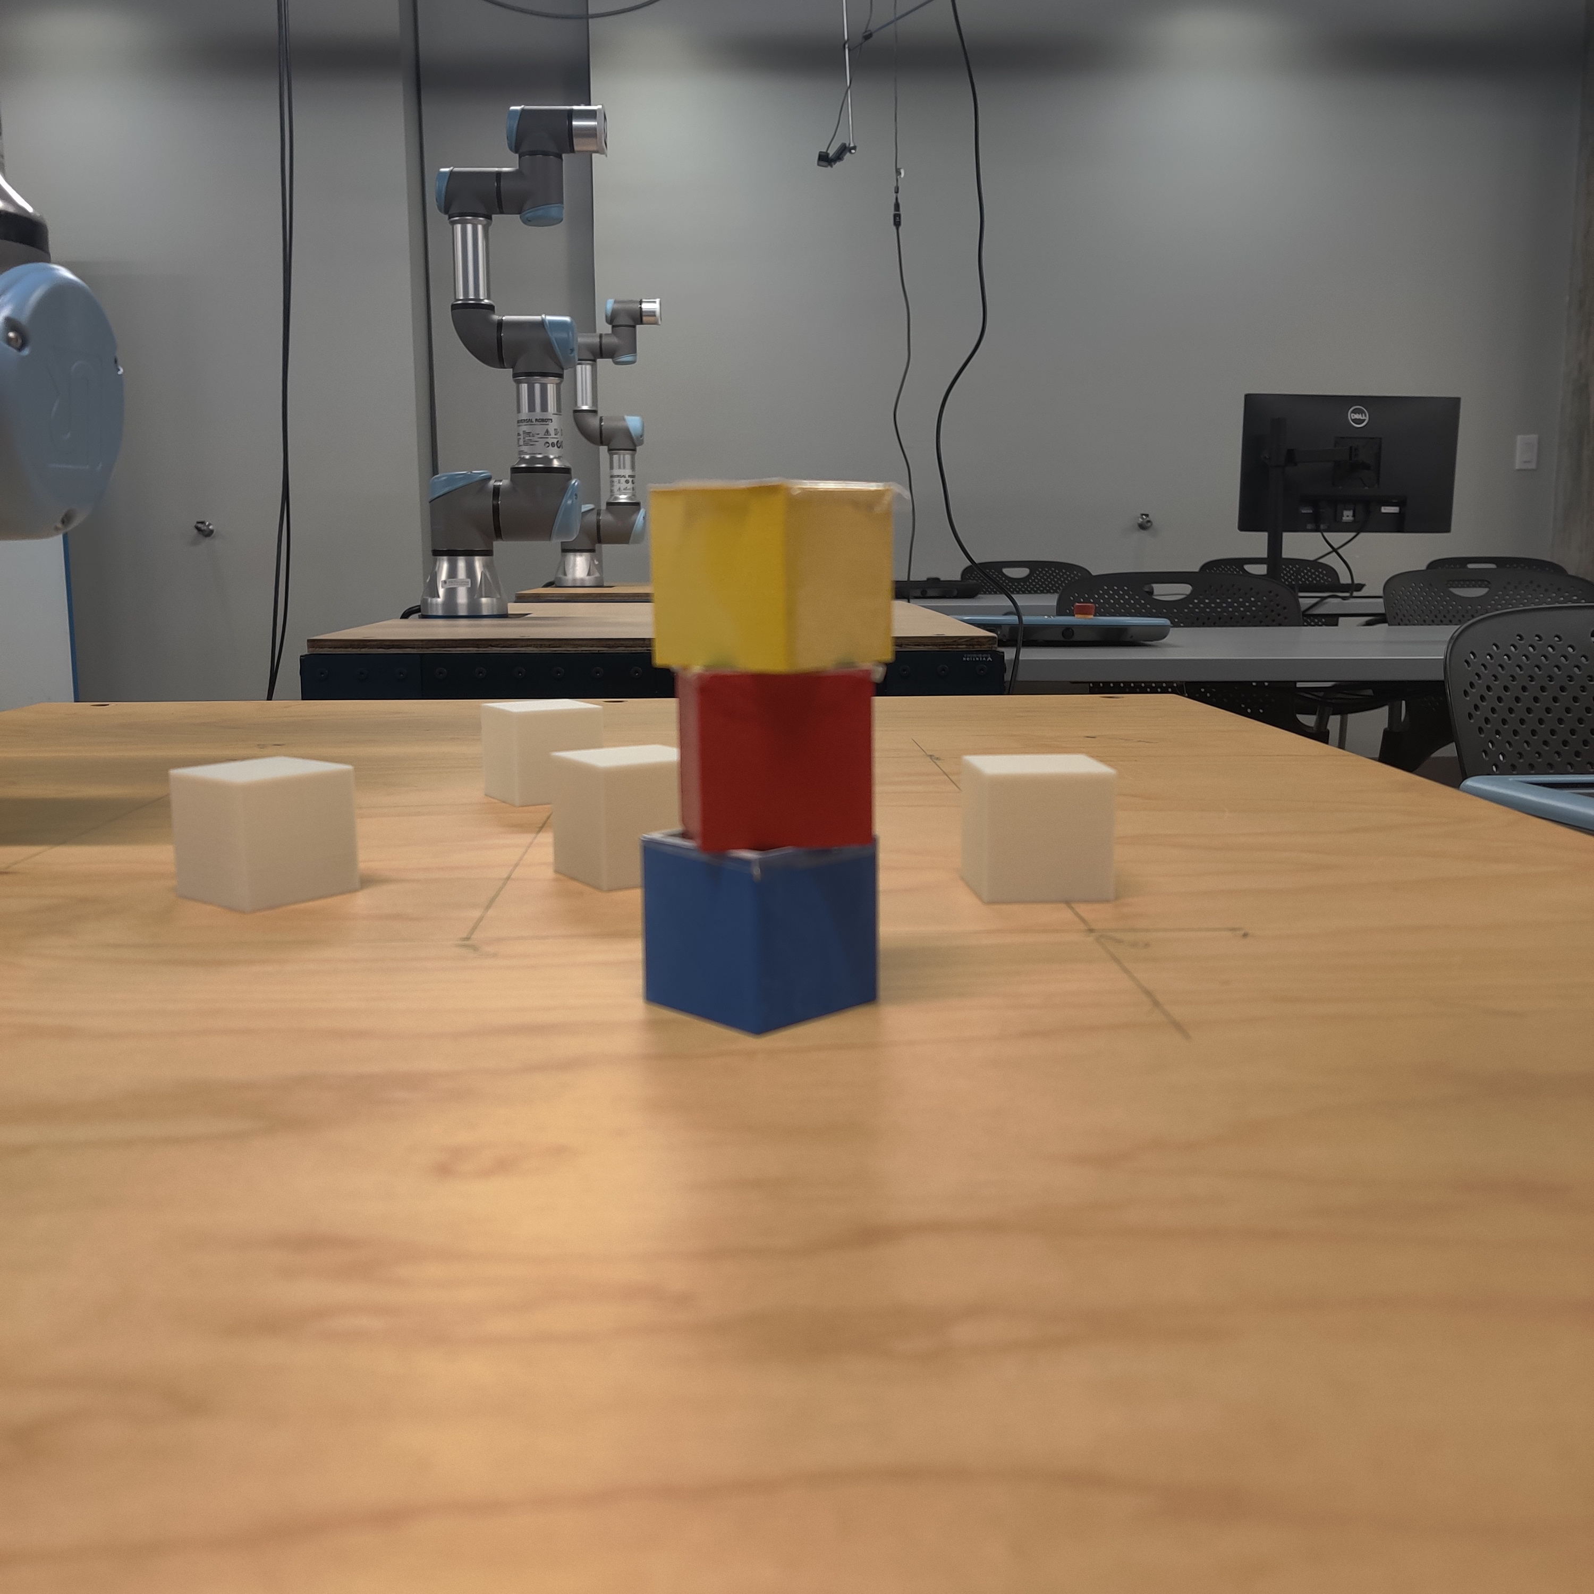
Final Project Intro
Minimum Acceptable
Initial Configuration
Extra Credit Competition
(Amount TBA)

Slide 6
Final Project Intro
Block Center
Coordinates
Camera
Image
Object Detector
Inverse Kinematics
If there are still
blocks to stack
or error is too high
Pose Estimate
Forward Kinematics
Otherwise
100% Final Project Score ☺

Slide 7
Final Project Intro
Block Center
Coordinates
Camera
Image
Object Detector
Inverse Kinematics
If there are still
blocks to stack
or error is too high
Pose Estimate
Forward Kinematics
Otherwise
This is the hard part!
100% Final Project Score ☺

Slide 8
Camera Lab Intro
So far, we’re experts in moving our robot around and having it interact with the workspace – but our robot is deaf, dumb and blind due to having no sensors
Givens:
At least 3 blocks on the same table, with distinct markings (i.e. different colors or AR tags)
Blocks will always be within a predefined workspace the camera can see
Mounting point of the camera
Want: Position of the blocks in workspace coordinates

Slide 9
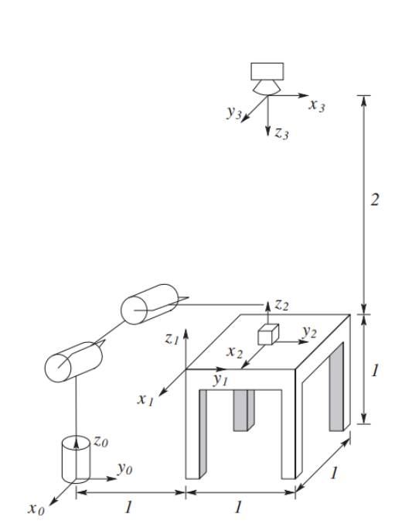
Camera Lab Intro
Two main problems to solve:
How do we translate the block position from pixels in the image to coordinates in the workspace?
How do we find the block in the image?
Hint: Remember this
homework question?

Slide 10
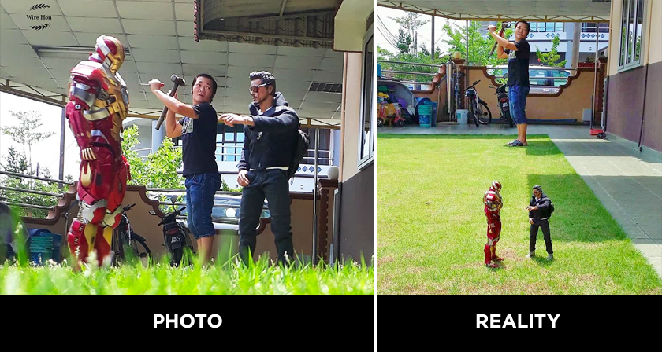
Camera Lab Intro - Calibration
Image from the camera is in pixels – how large is 1px?
It depends on the camera, the resolution and the distance
What if the camera has a fisheye lens?
What if the camera has a weird perspective?
Source: Digital Synopsis

Slide 11

Camera Lab Intro - Calibration
We use OpenCV, a common computer vision package, to calibrate our cameras
If we pick known points in space, we can find their distance in pixels from the image frame and convert pixels to millimeters
Most camera lenses are nonlinear; what does this mean for us?
Camera with a linear lens
Workspace with known corners in mm and px
Camera with a nonlinear lens
Workspace with known corners in mm and px

Slide 12
Camera Lab Intro - Calibration
Camera with a nonlinear lens
Camera with a nonlinear lens
Workspace after applying nonlinear transform to fix warped perspective
Camera with a nonlinear lens
Orange and pink lines are the same physical length, but are different sizes in the image
Workspace kept small enough that nonlinear perspective leads to small errors

Slide 13
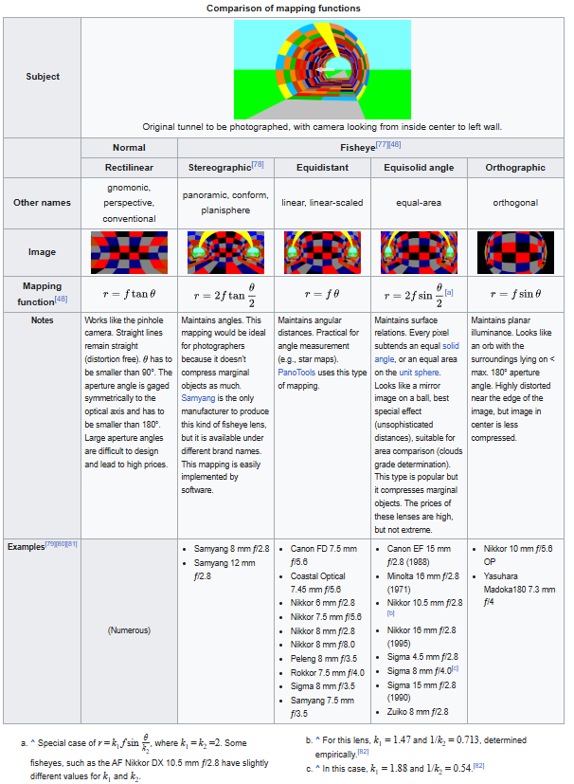
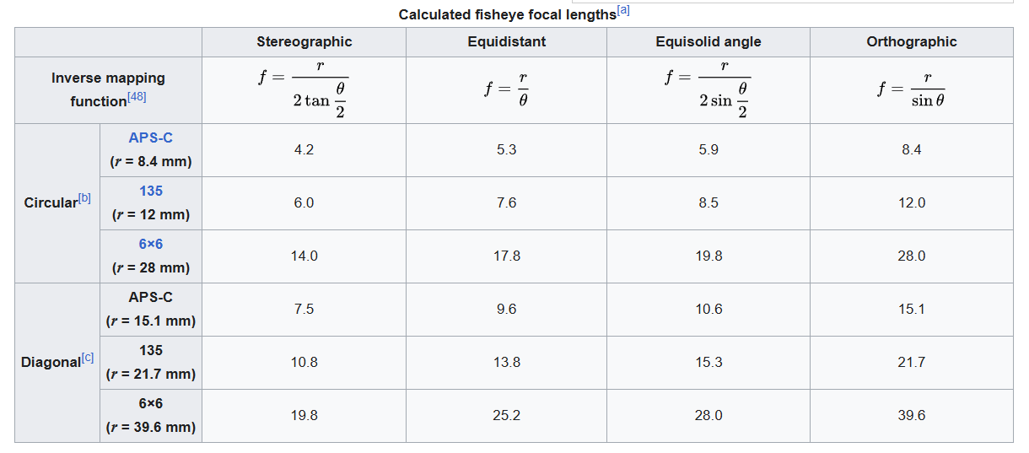
Camera Lab Intro - Calibration
This is all taken from the Wikipedia page on fisheye projections – calibrating one of these is a drawn out design process with multiple steps and tradeoffs

Slide 14
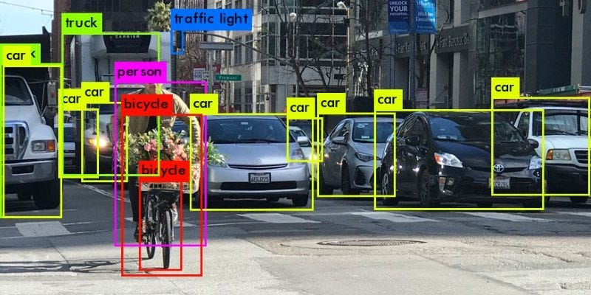
Camera Lab Intro - Detection
We now have an image whose pixel coordinates can be translated into physical positions, how do we find objects?
Source: AITS Journal on Medium

Slide 15
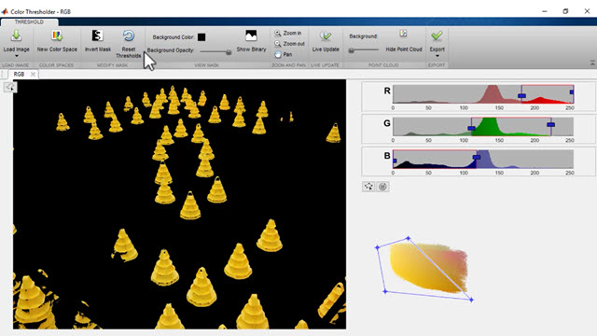
Naïve Approach – Color Thresholding
Simple approach: we know the blocks are all solid, bright colors – filter for all pixels close to that color then find the center point of them
What issues might this cause?
Source: Mathworks

Slide 16
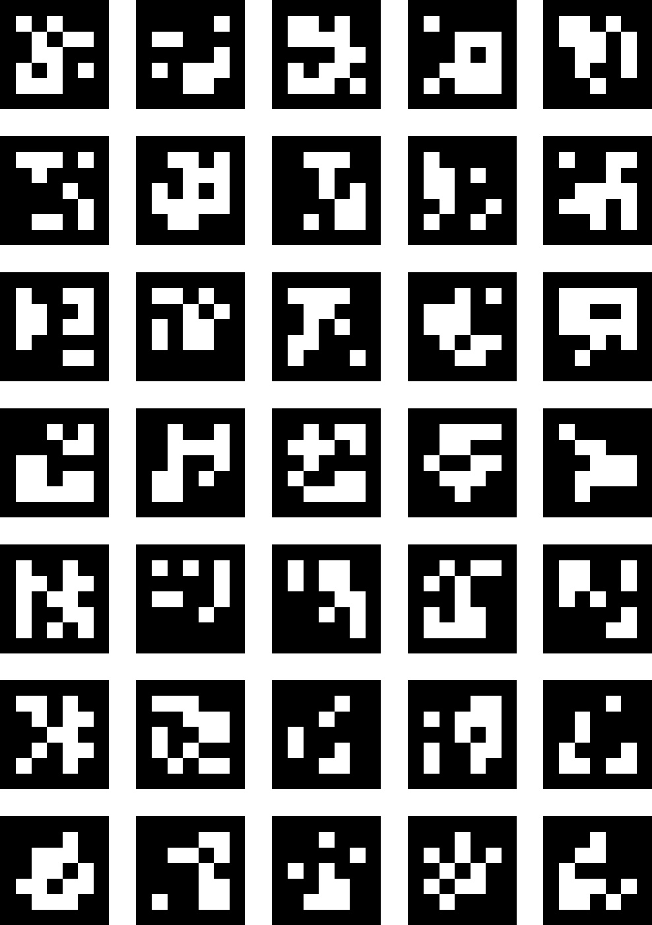
Object Detection – ARUCO Tags
We use ARUCO markers – special grids of pixels with known shapes and sizes – for object detection
There are many off the shelf solutions for this (OpenCV)
We will give you the detection code, but it will be up to you to calibrate it properly for your robot

Slide 17
Velocity Kinematics, Singularities & IK
We’ve talked about the what of singularities, but not so much about the why
Velocity Kinematics gives us the tools to characterize and locate singularities

Slide 18
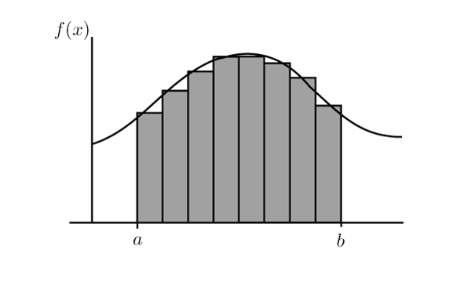
Numerical Methods
This is the barest bones version of the basics!
Instead of solving a large, complex equation outright break it into smaller, easier to solve steps and add those together!
Lowering the per step error ←→ Lowering the overall error
If you’ve ever used FEA Software (CAD) or an integrator in Python/MATLAB (ode45) this is what you’ve been doing!
Think of Riemann Integration

Slide 19
Implementation
Instead of thinking about the problem as “drive my end effector to a given position” let’s think about it as “how far away is my end effector from the final position?”
This is now an optimization problem
This is easier to optimize now, but we still don’t have a clear function to solve to get zero error
What should our next step be?

Slide 20
Implementation - Approach
Start with an initial guess for the state q_{i} and calculate its error
Generate another guess, offset by some amount and calculate its error
Think back to Calc 1, what can we say about optimality by doing this?
Use this to inform your next guess and check again
Remember to use your constraints to inform your next guess(es), they can narrow down the number of valid next guesses
Repeat this process until your error is below a threshold value

Slide 21
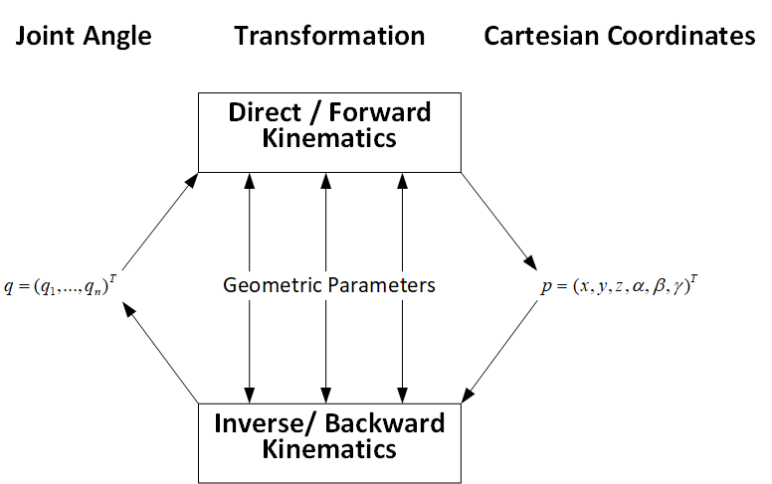
Implementation - Structure
Now we have a clearer understanding of our problem, but how do we find the error?
Forward Kinematics!
An estimate for the cartesian end effector which position will inform…
A guess for the robot angles which will inform…

Slide 22
Descent Methods – Background
Potential Problems:
Motions in joint space aren’t clearly mapped to cartesian space
Local (but not global) minima
This 2 DoF planar case doesn’t have any, but higher DoF cases would
By extension, we are extremely sensitive to ICs
Need to calculate rate of change for a function we might not know
Numerical Derivatives
Stationary points
Added complexity → higher chance for the math to break down
Notes:
Think analytic vs numeric!!!

Slide 23
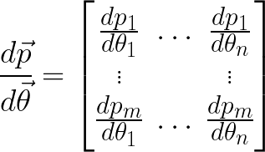
Descent Methods – Jacobians
Yields an m by n Jacobian
What is the Jacobian telling you? What can we use this information for?
The derivative of m states
With respect to n variables
Notes:
Think analytic vs numeric!!!

Slide 24
Numerical Methods– Identifying Singularities
Two main types of singularity:
Boundary Singularities
Occur when hyperextending a joint, determined by the physical structure of the robot
Internal Singularities
Purely mathematical, typically caused by the joint axes aligning during a movement
Result in either an infinite number of solutions (we need some choice criteria) or result in math that, when worked out, requires infinite joint velocity/force
Ex: two axes aligning such that the motion in one perfectly cancels the motion in the other
Notes:
Solution space loses dimensions for internal singularities; equivalent to no longer having a unique solution to things
We can spot this via the Jacobian, but I’ll leave that for a later class that can spend multiple lectures building this idea (its incredibly powerful and I don’ want to misspeak)

Slide 25
Numerical Methods– Identifying Singularities
Two main types of singularity:
Boundary Singularities
Boundary singularities are usually identified by deriving the robots workspace i.e. the set of all points the end effector can sweep out
For simple geometries we can do this mathematically, for more complex geometries methods like Monte Carlo sampling are used
Notes:
Solution space loses dimensions for internal singularities; equivalent to no longer having a unique solution to things
We can spot this via the Jacobian, but I’ll leave that for a later class that can spend multiple lectures building this idea (its incredibly powerful and I don’ want to misspeak)

Slide 26
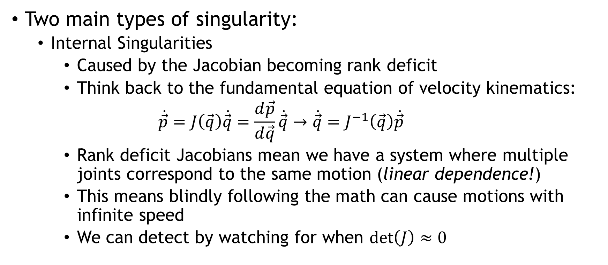
Numerical Methods– Identifying Singularities
Two main types of singularity:
Internal Singularities
Caused by the Jacobian becoming rank deficit
Think back to the fundamental equation of velocity kinematics:
$$\dot{\vec{p}}=J\left(\vec{q}\right)\dot{\vec{q}}=\frac{d\vec{p}}{d\vec{q}}\dot{\vec{q}}→\dot{\vec{q}}=J^{−1}\left(\vec{q}\right)\dot{\vec{p}}$$
Rank deficit Jacobians mean we have a system where multiple joints correspond to the same motion (linear dependence!)
This means blindly following the math can cause motions with infinite speed
We can detect by watching for when $\det\left(J\right)≈0$
Notes:
Solution space loses dimensions for internal singularities; equivalent to no longer having a unique solution to things
We can spot this via the Jacobian, but I’ll leave that for a later class that can spend multiple lectures building this idea (its incredibly powerful and I don’ want to misspeak)

Slide 27
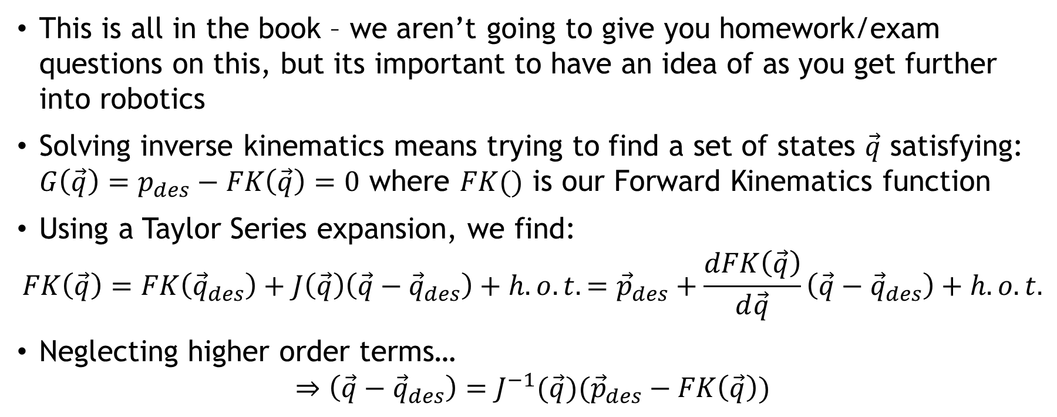
Numerical Methods – Jacobians
This is all in the book – we aren’t going to give you homework/exam questions on this, but its important to have an idea of as you get further into robotics
Solving inverse kinematics means trying to find a set of states $\vec{q}$ satisfying: $G\left(\vec{q}\right)=p_{des}−FK\left(\vec{q}\right)=0$ where $FK()$ is our Forward Kinematics function
Using a Taylor Series expansion, we find:
$$FK\left(\vec{q}\right)=FK\left({\vec{q}}_{des}\right)+J\left(\vec{q}\right)\left(\vec{q}−{\vec{q}}_{des}\right)+h.o.t.={\vec{p}}_{des}+\frac{dFK\left(\vec{q}\right)}{d\vec{q}}\left(\vec{q}−{\vec{q}}_{des}\right)+h.o.t.$$
Neglecting higher order terms…
$$⇒\left(\vec{q}−{\vec{q}}_{des}\right)=J^{−1}(\vec{q})({\vec{p}}_{des}−FK\left(\vec{q}\right))$$

Slide 28
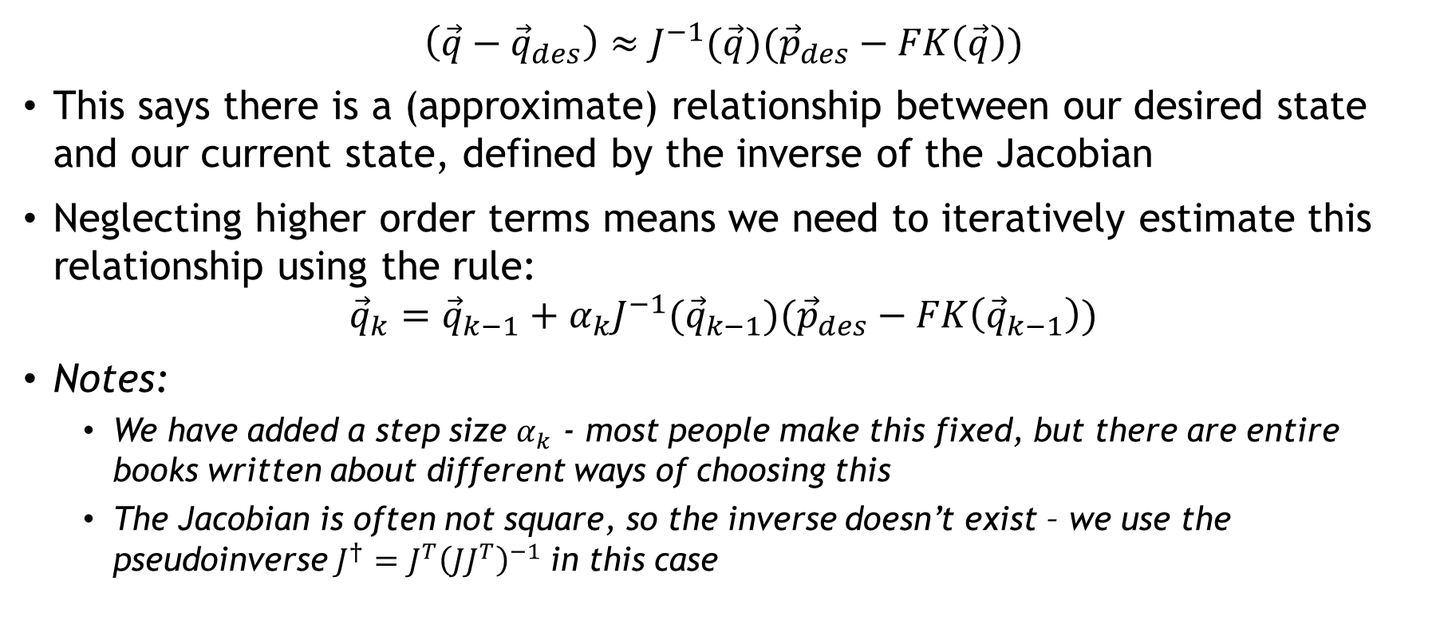
Numerical Methods – Jacobians
$$\left(\vec{q}−{\vec{q}}_{des}\right)≈J^{−1}(\vec{q})({\vec{p}}_{des}−FK\left(\vec{q}\right))$$
This says there is a (approximate) relationship between our desired state and our current state, defined by the inverse of the Jacobian
Neglecting higher order terms means we need to iteratively estimate this relationship using the rule:
$${\vec{q}}_{k}={\vec{q}}_{k−1}+α_{k}J^{−1}({\vec{q}}_{k−1})({\vec{p}}_{des}−FK\left({\vec{q}}_{k−1}\right))$$
Notes:
We have added a step size $α_{k}$ - most people make this fixed, but there are entire books written about different ways of choosing this
The Jacobian is often not square, so the inverse doesn’t exist – we use the pseudoinverse $J^{†}=J^{T}{\left(JJ^{T}\right)}^{−1}$in this case

Slide 29
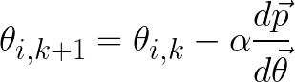
Numerical Methods – Implementation
For end effector position p and joint state θ (both vectors):
Pick an initial condition
Set a desired precision and repeat:
Calculate dp/dθ
Pick a direction (randomly or otherwise)
Update your guess according to:
Update error, break if you’ve reached your desired precision
Notes:
Think analytic vs numeric!!!

Slide 30
Implementation - Issues
Forward Kinematics have the advantage of always working for a valid set of angles; not all valid points will work nicely in IK
Multiple sets of angles can correspond to one point, how do we pick?
Some singularities are purely mathematical; the math might say you’re stuck in a certain pose and can’t move but physically there’s nothing stopping you

Slide 31
Breaking Descent Methods
To understand how the method works, we also need to understand why it doesn’t
Think back to the list of issues before, which ones will we still face?
Notes:
Think analytic vs numeric!!!

Slide 32
Breaking Descent Methods
To understand how the method works, we also need to understand why it doesn’t
Think back to the list of issues before, which ones will we still face?
Sensitivity to ICs – fundamental to the method
Local Minima – also fundamental to the method
Stationary Points – we can design corrections for this
IK Singularities – needs investigating
Notes:
Think analytic vs numeric!!!

Slide 33
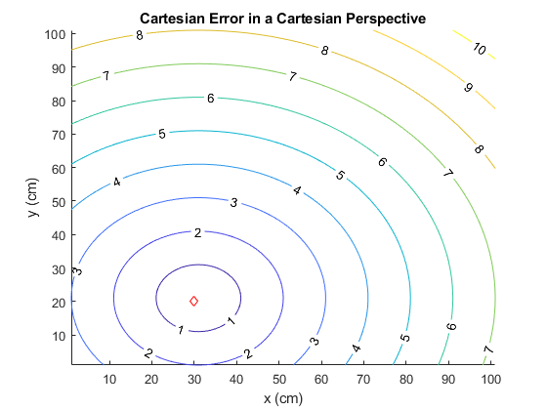
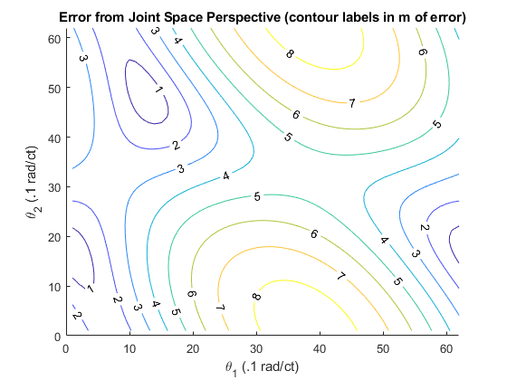
Implementation
We mentioned how moving in joint space is difficult, let’s revisit this concept: (desired point: <3,2>)
Notes:
Y=mx+b (technically affine) → solve for 0 → we’re finding this proportionality relationship btwn y and x then using it to backsolve in one step
This does not work for nonlinear systems

Slide 34
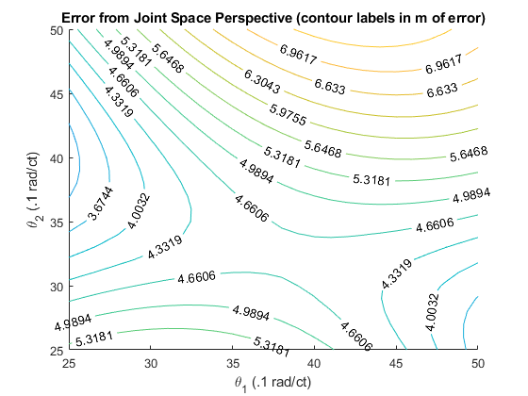
Breaking Descent Methods – Stationary Points
Stationary points in the error function behave like valid solutions (locally) with high error
How do we fix?
Perturb our guess for θ by Δθ in all directions, increasing the magnitude of Δθ if we fall back to the same point
This thought process broadly applies to local minima as well
Notes:
Think analytic vs numeric!!!

Slide 35
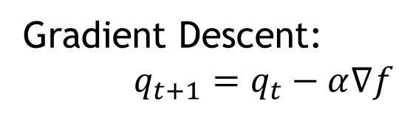
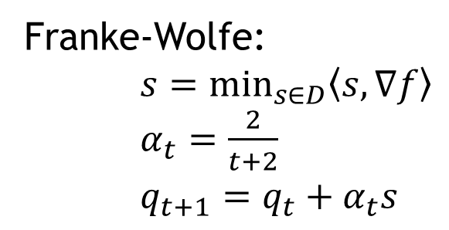
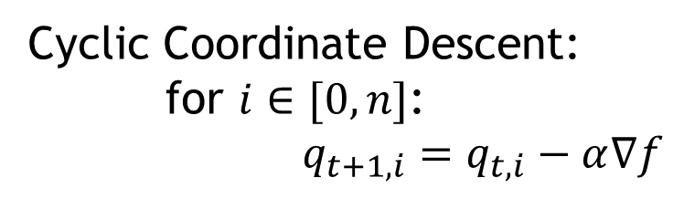
Descent Methods – Examples
Three methods:
Gradient Descent:
$q_{t+1}=q_{t}−α∇f$
Cyclic Coordinate Descent:
for $i∈[0,n]$:
$q_{t+1,i}=q_{t,i}−α∇f$
Franke-Wolfe:
$s=\min_{s∈D}\left\langle s,∇f\right\rangle$
$α_{t}=\frac{2}{t+2}$ $q_{t+1}=q_{t}+α_{t}s$
These methods will be shown on a two link and a six link robot (there is also a combined Frank-Wolfe/CCD script
Notes:
Think analytic vs numeric!!!

